Slide 1






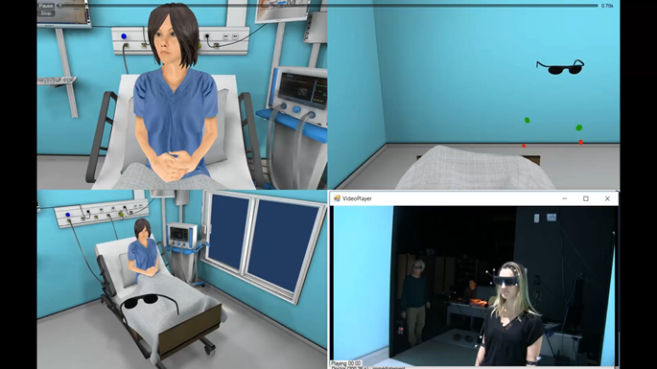

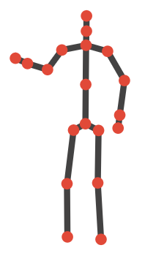

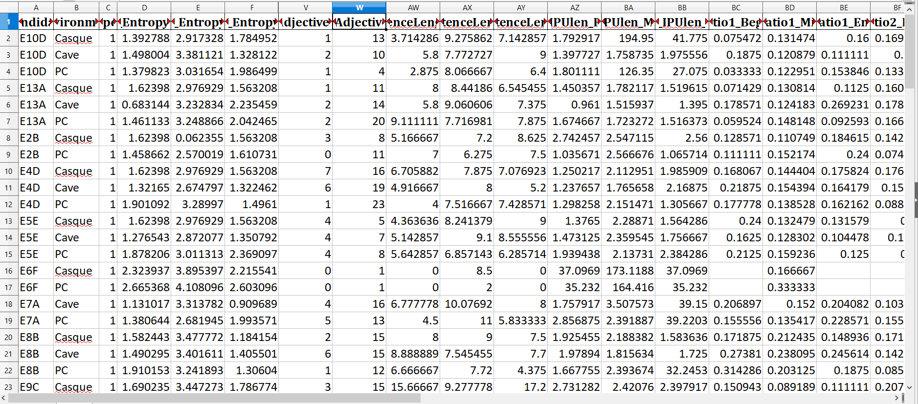

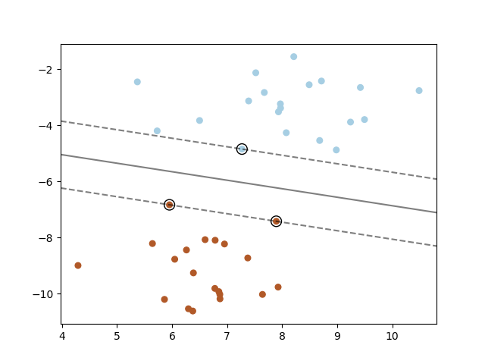
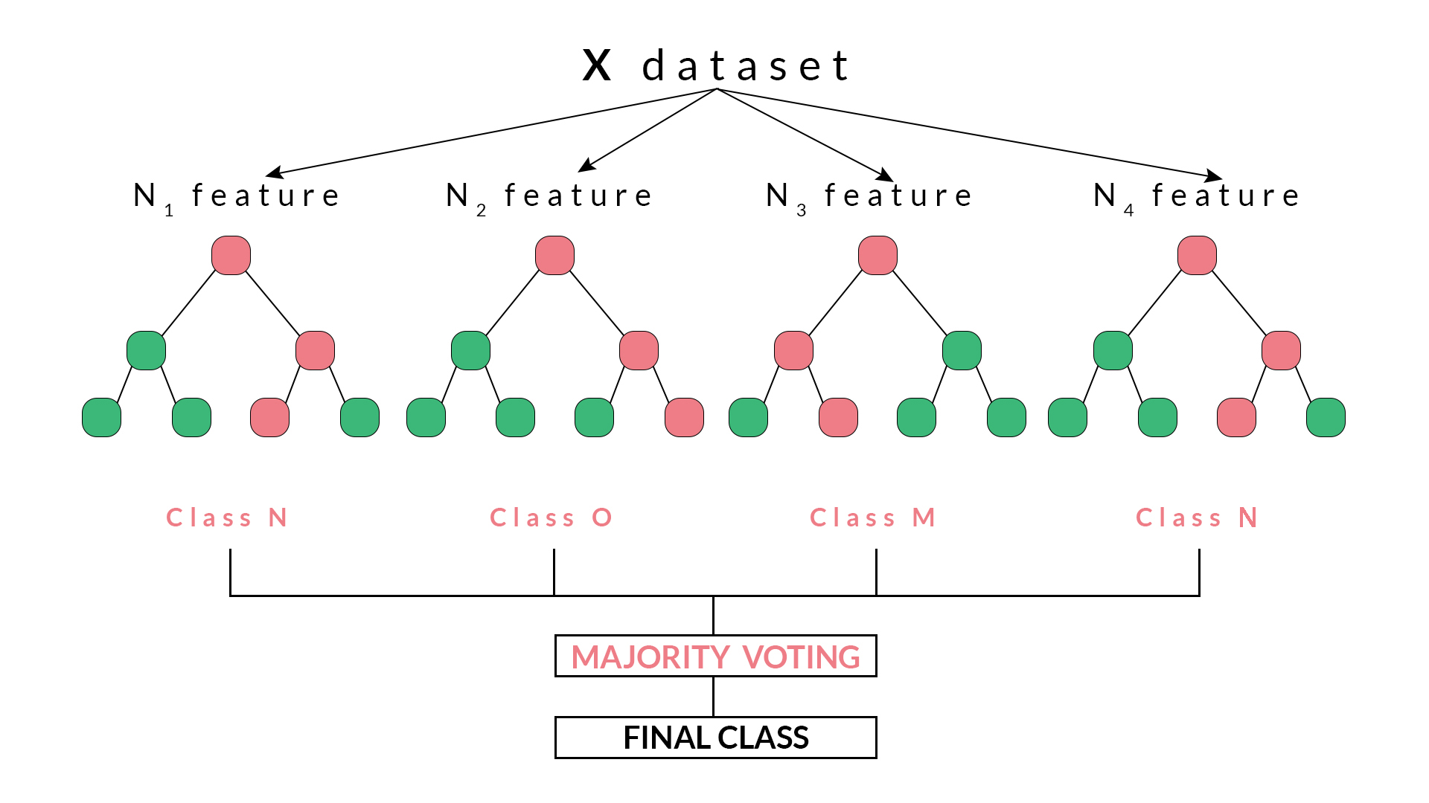
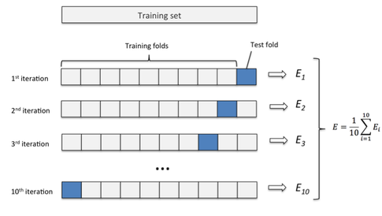
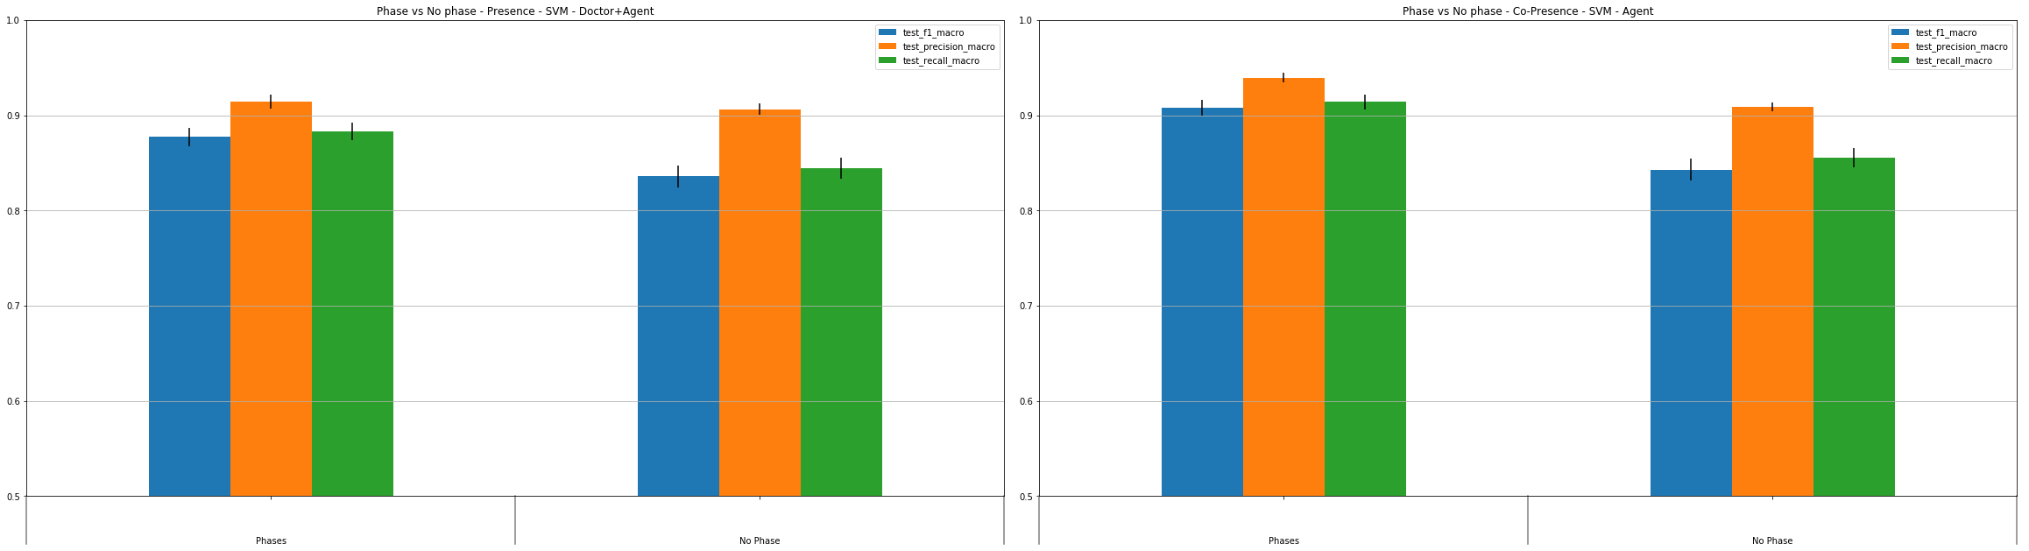
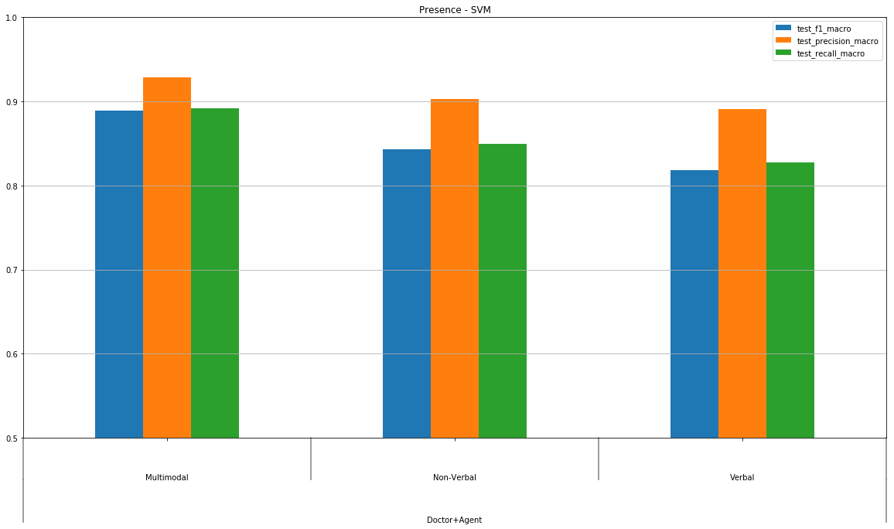
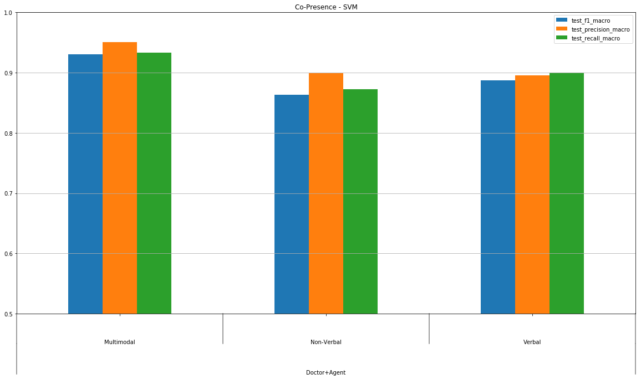
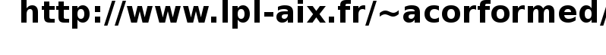
Multimodal cues of the sense of presence and co-presence
in human-virtual agent interaction
Magalie Ochs, Jérémie Bousquet and Philippe Blache
Virtual reality environment
with an autonomous virtual patient
Collected corpus of human-machine interaction
Corpus of 108 interactions (36 persons among which 10 doctors) – 6 hours (3mn16/interaction)
Video in the three environments with different levels of immersion : a virtual reality cave, a virtual reality headset, a PC
Time-series three-dimensional unity coordinates of head, hand and arms.
Audio file, transcribed automatically with an ASR system
Presence and co-presence subjective experience of the participants (IPQ Post-experience questionnaire)
Automatic Prediction
Level of sense of presence (immersion)
Level of co-presence (social immersion)
DATA
Reduce the dimensionality of the data
Define Interpretable parameters
Automatic extraction of
high-level verbal and non-verbal features
Pre-process of the data
Split interaction in phases
Definition of high-level features
CLASSIFIERS
Experiments on prediction of presence and co-presence class
search of best hyper parameters
for the classifiers
10x 10-folds cross-validation
Support Vector Machines
Random Forests
What have we learnt ?
Performance scores for the prediction
of presence and co-presence
MACHINE LEARNING
Importance of discourse segmentation to predict the sense of presence and co-presence
Cues of presence :
behaviour of both participants
Cues co-presence :
virtual agent’s behavior
Sense of presence and co-presence expressed through multimodal behavioural cues of

